Slide 1
Digital Scent

Slide 2
Overview of Digital Scent
Digital Scent is a new feature in DuerOS phase 4. For this feature, a new device should be connected to IVI , the device’s B sample will be released in May. 2020 by another supplier.
The new device is connected to IVI by Lin bus, IVI could control the device and get status of the device. The setting of the device could be customized per personal preference . The B sample could support the Lin communication. The Lin messages table is updating.
LIN message
Scent System Open Request
Scent Cartridge Open Request
Scent Intensity Adjust Request
Scent ID Confirm
Vehicle System Power Mode
Cartridge1/2/3 scent life time
Scent System Error
Scent ID information
Scent System Controller Software Version
Scent System Controller Hardware Version
Lin Message
IVI
Fragrance Module
Lin bus

Slide 3
Impact on IVI
Impact Part | Sub part | Function Description | Desay/Baidu | Ford
IVI | MCU BSP | 1. Detect the new Lin device 2. handle the Lin message between IVI and new device | Desay develop | NA (Fragrance module SW/HW will be delivered by another supplier)
 | Framework service Framework Interface | 1.Provide all the control interface of the new device to APP 2.OTA of scent module support | Desay/Baidu develop | NA
 | Application | Add the new device status page and Setting page Save setting data to Lincoln profile. Add a new APP for this feature , this APP will control other modules, such as ambient light, A/C, Massage, Audio. | Add an setting item for Digital scent. Add a entry of digital scent in launcher. Open the enhance memory interface of Lincoln. Open vehicle control interface such as ambient light, A/C, Massage, Audio. Open the interface of Notification center Add several voice command to control the device Support new APP integration in DuerOS phase 3 | Ford in-house team will develop the Digital scent APP including the HMI design

Slide 4
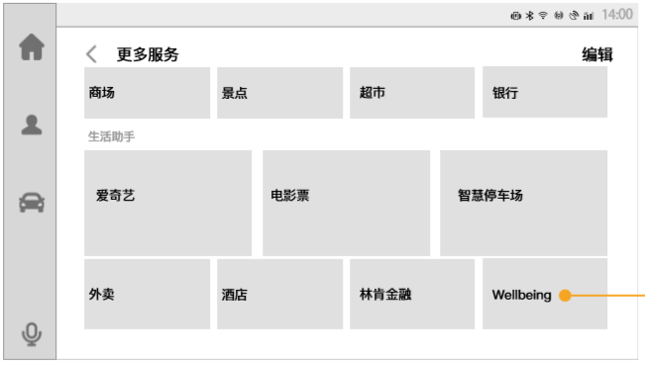
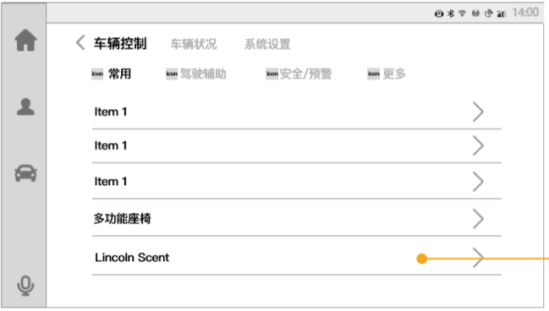
UE porotype

Slide 5
接口依赖
接口类型 | 接口模块 | 接口功能 | 接口提供
android | Launcher | 在Launcher上添加Wellbeingt应用的启动入口 | Baidu/Desay提供
 |  | Launcher主页上卡片的添加移除接口（Wellbeing在后台时需要保活）
 | 消息中心 | 消息中心显示接口（香氛余量较低时）
 | 设置 | 设置种添加香氛设置的条目接口
 |  | 点击香氛设置条目，页面跳转的功能的添加
 | 语音 | 语音命令的添加（大约12条，每条对应多种不同的说法，比如“打开 香水”“打开香氛”，“我想闻香味”，“放点香味”对应一条指令） 语音指令内容： 语音控制香氛开关/强度/选择味道 语音控制打开Wellbeing的模式（3种模式）
 | 车钥匙账号绑定 | 提供查询当前钥匙的profile的接口
 |  | 钥匙profile改变时的广播
 |  | Duros系统启动时的开机广播（是否延用android原生）
车控 | 座椅按摩 | 座椅按摩主副驾开关 | Desay提供
 | 香氛 | 香氛开关
 |  | 香氛强度
 |  | 香氛剩余量
 | 氛围灯 | 灯开关
 |  | 灯颜色/亮度

